Slide 1
Motion Of an orbiter under tidal perturbations
Enrique Babio
2018

Slide 2
MOTIVATION
Exploration of the Outer Solar System:
Icy Moons of giant planets could support life
Orbiter missions:
Jupiter Europa Orbiter –Laplace, JUICE
Characteristics:
Scientific orbits have high inclination
Strong tidal perturbation from Jupiter
Notes:
Icy Moons are among priorities for Space Exploration.
Jupiter Europa Orbiter - Laplace was a joint NSA-ESA mission, it was cancelled due to budget constraints.
ESA’s JUICE will orbit Ganymede and the mission will finish impacting on it, due to planetary protection policies this cannot be done in Europa.
Scientific orbits want to gather as much information as possible, we want to visit all the satellite.

Slide 3
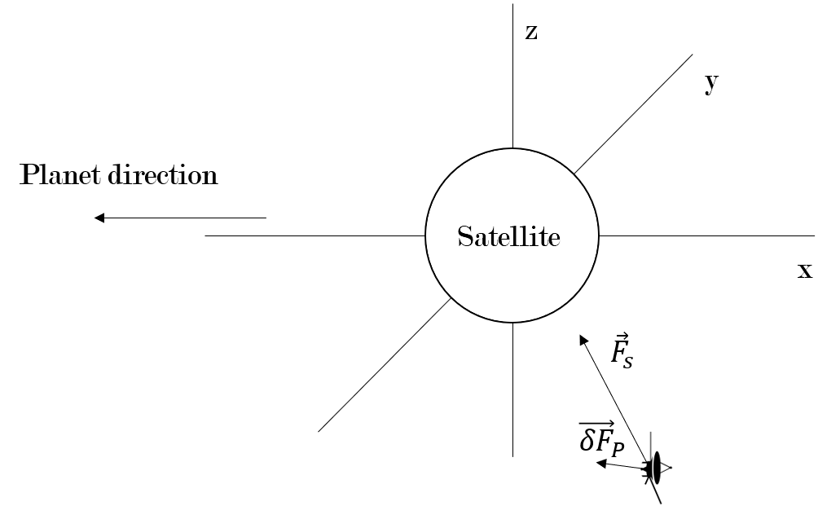
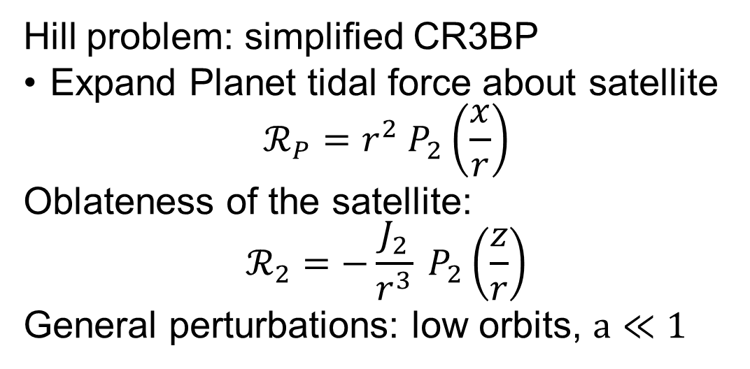
MODEL: SCHEERES
Hill problem: simplified CR3BP
Expand Planet tidal force about satellite
$$ℛ_{P}=r^{2} P_{2}\left(\frac{x}{r}\right)$$
Oblateness of the satellite:
$$ℛ_{2}=−\frac{J_{2}}{r^{3}} P_{2}\left(\frac{z}{r}\right)$$
General perturbations: low orbits, $a≪1$
Notes:
Hill problem assumes that the bigger primary is much bigger, only the motion about the smaller primary is considered. Fits perfectly the gaseous giant systems in the solar system.
The reference frame rotates so that x always points to the planet, the longitude of the node rotates.
Only zonal harmonics need to be considered, only J2 is considered.
This environment can lead to similar behaviors to that of the CR3BP, so we need small orbits to consider the perturbations small and apply general perturbations.

Slide 4
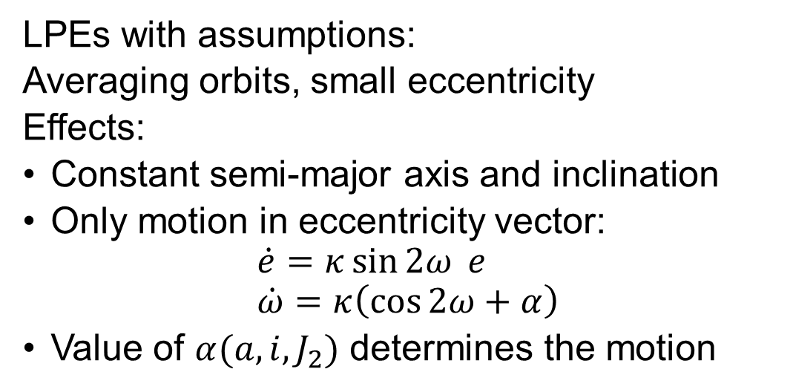
ANALYTIC Equations of MOTION
LPEs with assumptions:
Averaging orbits, small eccentricity
Effects:
Constant semi-major axis and inclination
Only motion in eccentricity vector:
$$\dot{e}=κ\sin{2ω} e \\ \dot{ω}=κ\left(\cos{2ω}+α\right)$$
Value of $α(a,i,J_{2})$ determines the motion
Notes:
We have averaged the disturbing function for one orbit about the satellite and then for one orbit about the planet. This coordinates become ignorable.
If we consider low altitude orbits, eccentricity must be small to prevent impacts against the surface.
If we look at the equations we see the argument of periapsis is decoupled from the eccentricity. It will increase monotonically or have stationary values depending on the value of alpha, there are two types of behavior.
The eccentricity increases of decreases depending on the value of the argument of periapsis.
Alpha is critical to the behavior of the system and is mostly affected by the inclination.

Slide 5
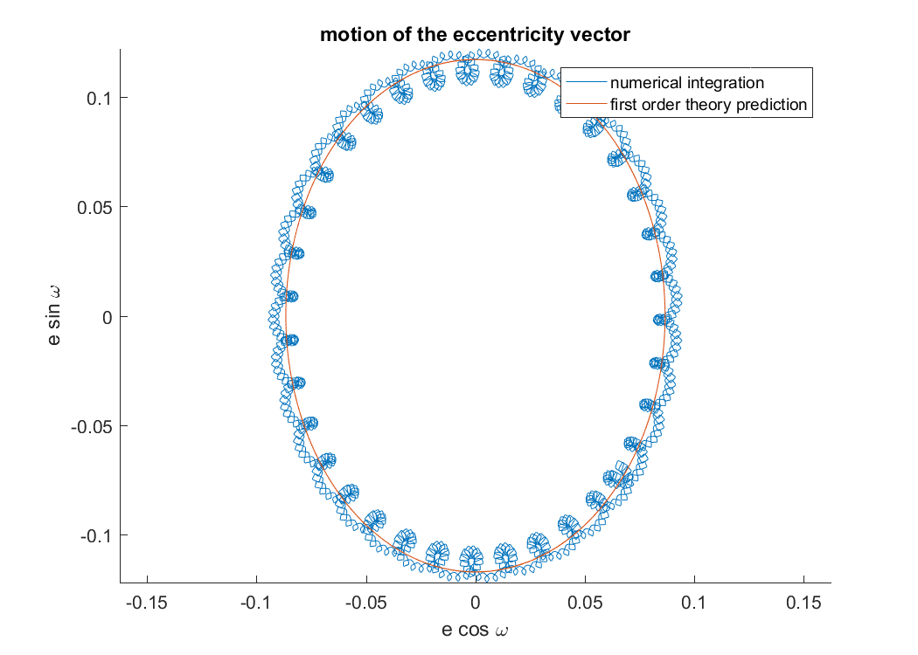
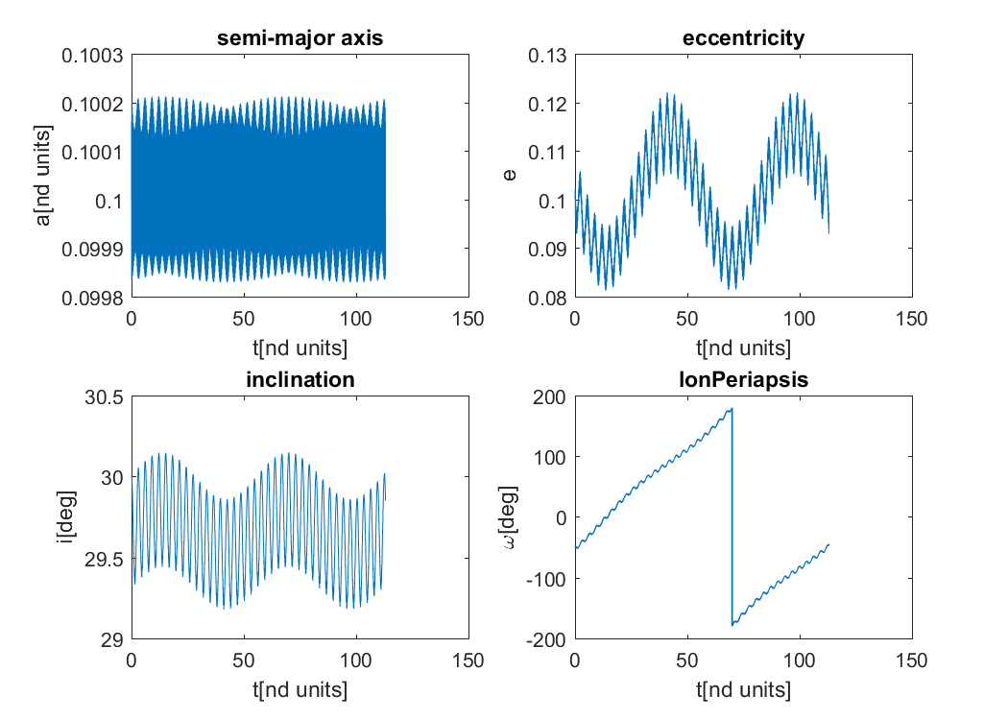
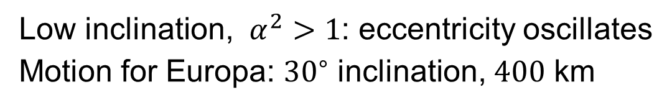
STABLE MOTION:
Low inclination, $α^{2}>1$: eccentricity oscillates
Motion for Europa: ${30}^{∘}$ inclination, $400$ km
Notes:
Scheeres here obtains an analytical solution, but I think numerical methods and maps offer greater insight.
We compare the results from the theory with numerical integrations to verify its accuracy
Argument of periapsis increases monotonically as expected, numerical integrations shows short period perturbations. Can be expected from averaging.
Semimajor axis and inclination are constant in average as expected.

Slide 6
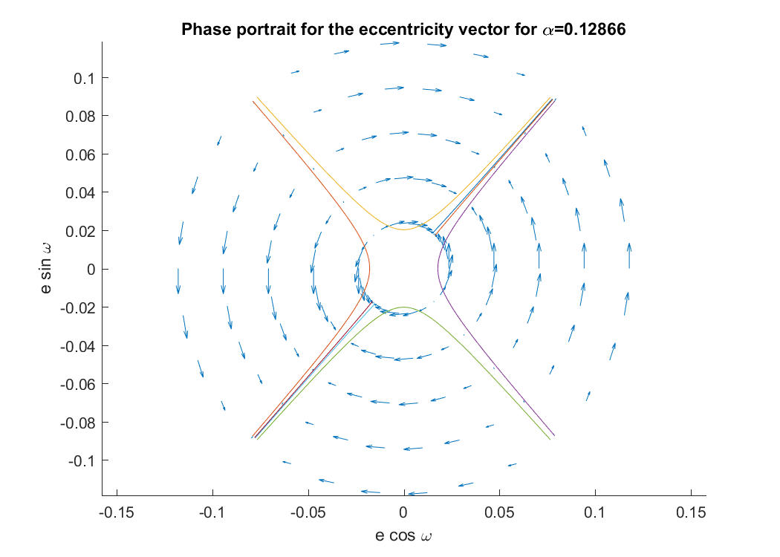
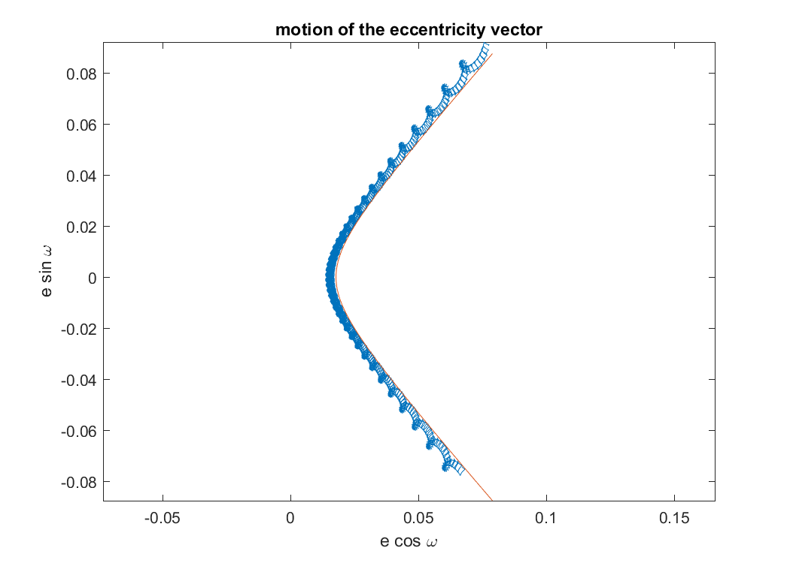
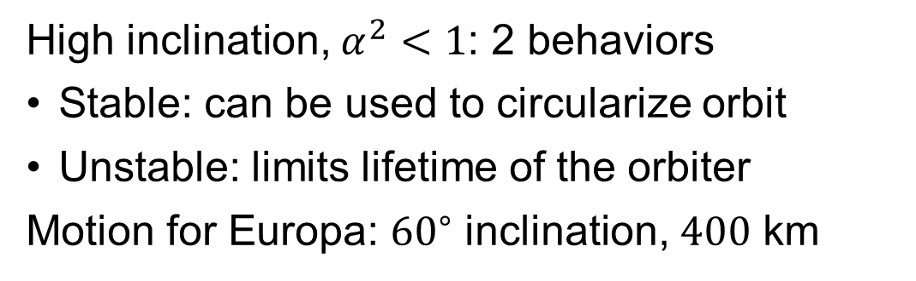
UNSTABLE MOTION
High inclination, $α^{2}<1$: 2 behaviors
Stable: can be used to circularize orbit
Unstable: limits lifetime of the orbiter
Motion for Europa: ${60}^{∘}$ inclination, $400$ km
Notes:
This would be the case of a scientific exploration orbiter. A whole new behavior arises with secular changes in the eccentricity. Not seen in class.
There is an attractive mode that decreases the eccentricity, can be used to circularize the orbit after a low altitude fly-y injection. New possibilities.
In a conservative system, an unstable mode must also appear. This will tend to decreases periapsis, leading to an impact with no controlled motion.
Unmodeled short term perturbations will end-up exciting the unstable mode, this limits the lifetime of the orbit. Short term perturbations also limit our ability to choose initial conditions.

Slide 7
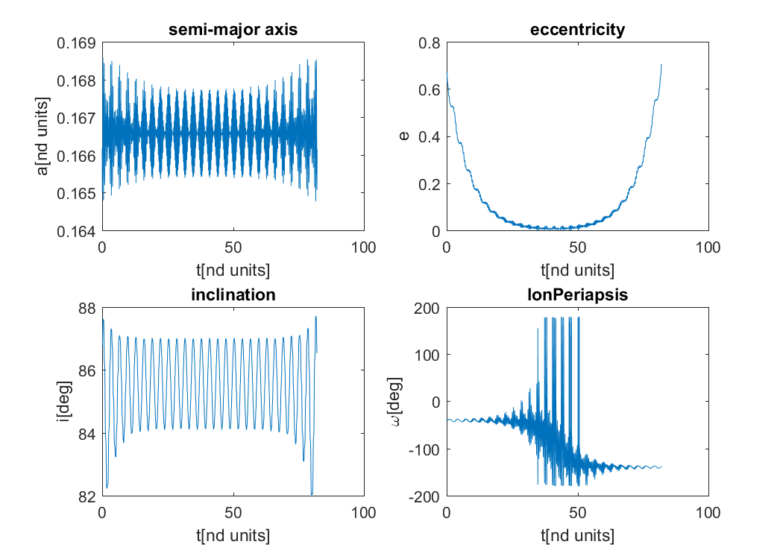
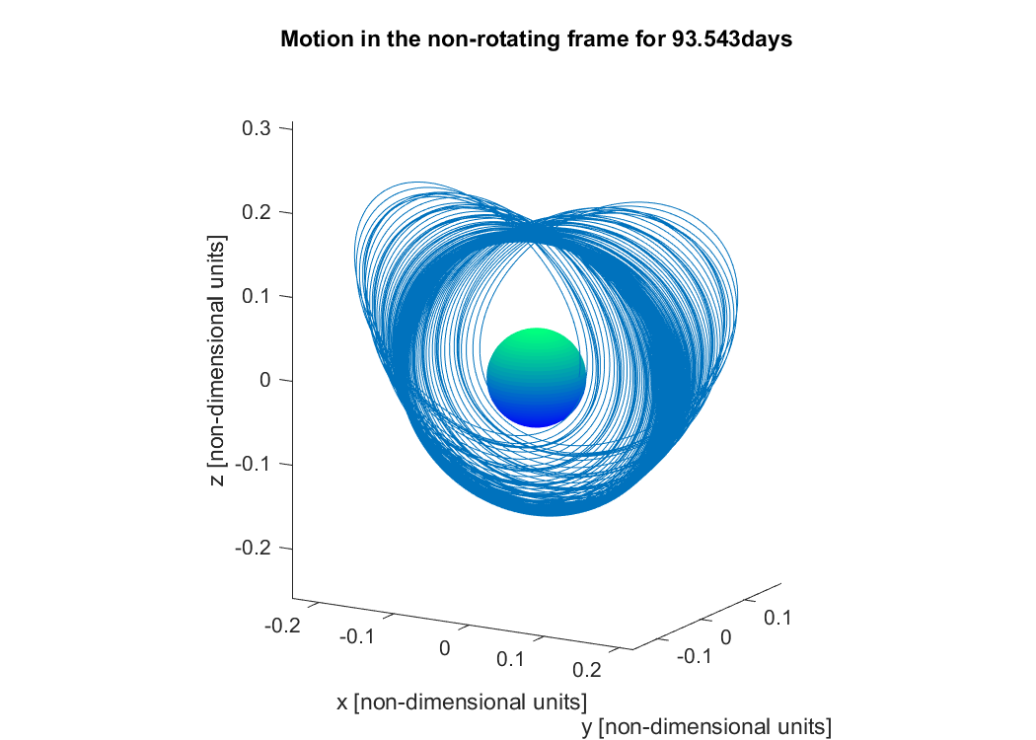
APPLICATION TO JUICE
ESA’s JUICE to orbit Ganymede
High eccentricity: reasonable predictions
Leverage the stable mode, eventual impact
Notes:
JUICE will be inserted into Ganymede using a 200x10000 altitude orbit on the attractive manifold.
The assumption of low eccentricity is completely violated, the behavior drifts away from the theory, but the insight is the same.
Numerical methods become increasingly more necessary to obtain effective ICs.
Globalizing the manifolds of a circular orbit we obtain a mission profile almost identical to that of ESA.

